Slide 1

Social Data News Site
About Movies
Anisha Ganguly
Fan Ji
Shashank Vaidya
Zhouwei Wang

Slide 2
Content
Introduction
Conceptual Model
Data Source
Challenges
Future Plans
Citation & Reference

Slide 3
INTRODUCTION
PART 1
Goals and Objectives
Requirements

Slide 4

Our Domain
MOVIE

Slide 5

Goals and objectives
Build up database
Create conceptual model
Gather and clean data for the domain of movies
Integrate data from different social media sources
Create tables and queries that could support specific questions
Notes:
This domain includes entities that represent the following attributes:
a. People - Actors, Directors
b. Places - Company/Production house Address
c. Things - Movies

Slide 6

Requirements
Collect data from four social medias
Tag the social media data that we collect
Update news and trend automatically over time
Answer some particular questions
i. What are people saying about me (somebody)?
ii. How viral are my posts?
iii. What posts are likely to be interesting to me?
iv. What posts are like mine?
v. What users post like me?
vi. Who should I be following?
vii. What topics are trending in my domain?
viii. What keywords/ hashtags should I add to my post?
ix. Should I follow somebody back?
Notes:
This domain includes entities that represent the following attributes:
a. People - Actors, Directors
b. Places - Company/Production house Address
c. Things - Movies

Slide 7
Conceptual Model
PART 2

Slide 8
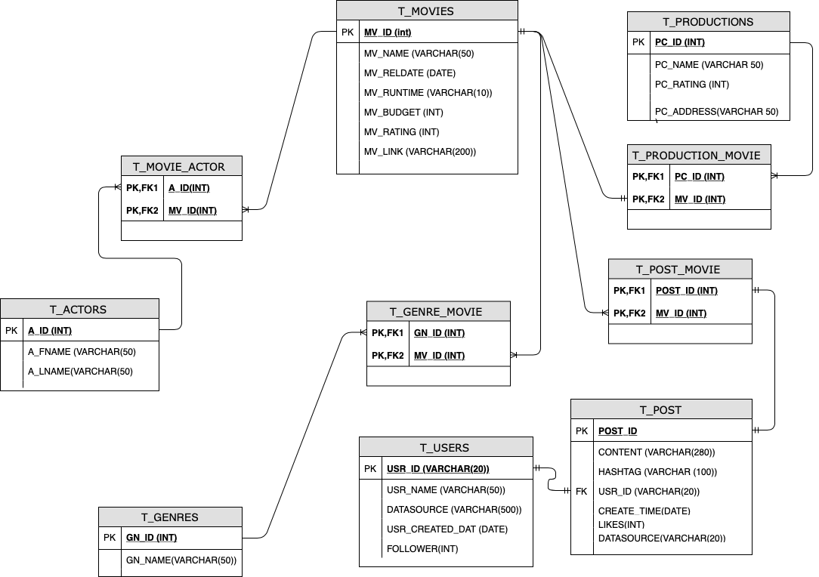
Conceptual Model

Slide 9
Data Sources and Challenges
PART 3

Slide 10




Data Sources
TMDB
https://developers.themoviedb.org/3/getting-started/introduction
Social Media API
https://developer.twitter.com/content/developer-twitter/en.html
https://www.instagram.com/developer/
https://www.youtube.com/yt/dev/api-resources/
https://www.youtube.com/yt/dev/api-resources/

Slide 11
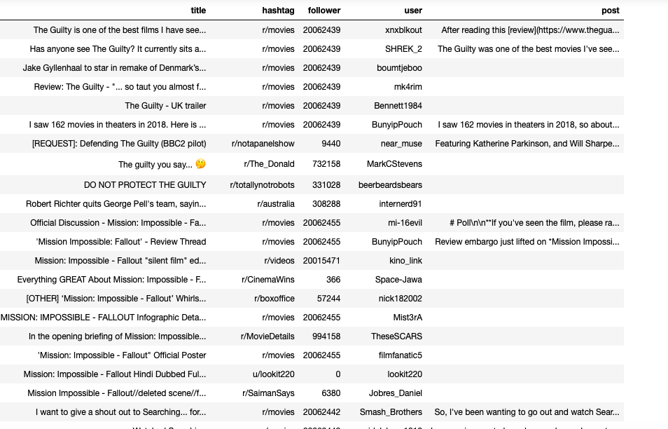
Data Sample
Reddit

Slide 12
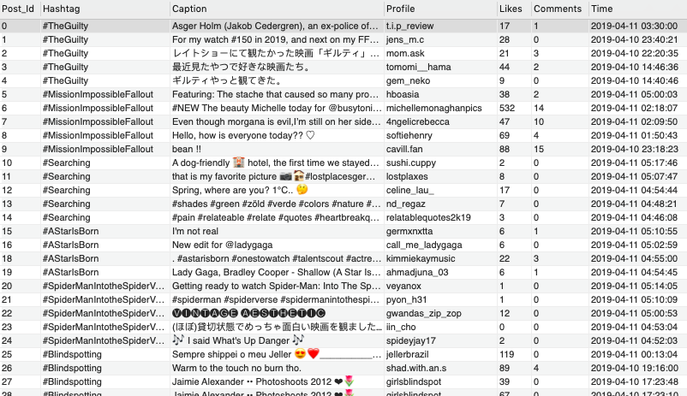
Data Sample
Instagram

Slide 13
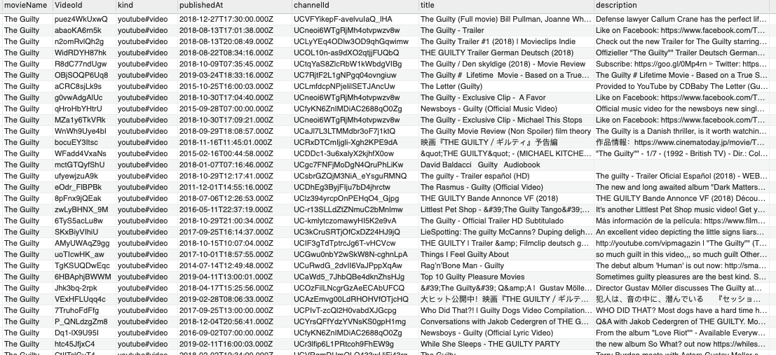
Data Sample
YouTube

Slide 14
Challenges
Poor data quality
Resource usage limitations
Combining data which are fetched from different sources together
Since the dynamic data is coming from the API in real time, the application is running a bit slow
Coming up with relevant answers to the SQL queries

Slide 15
Future Plan and References
PART 4

Slide 16
What’s Left?
Cleaning, auditing the data
Integrating all our data into the database and conceptual model
Thinking about and answering the SQL queries given to us
i. What are people saying about me (somebody)?
ii. How viral are my posts?
iii. What posts are likely to be interesting to me?
Create tables for the below
i. Domain tags (tags in your domain)
ii. Synonyms (which tags are synonyms?)
iii. Mis-spellings (mis-spelled versions of words)
iv. Semantic information (categories of tags)

Slide 17
Timeline
Topic Choice
Conceptual Model Design
Data Collecting
SQL Queries for analysis
Create tables as requirement
Organize the code and script
April 17
April 10
April 20
April 22
Cleaning Data
Integrate Data
Create Database
Ready to submit
Code Review

Slide 18
References
https://developers.themoviedb.org/3/getting-started/introduction
https://developer.twitter.com/content/developer-twitter/en.html
https://www.kaggle.com/tmdb/tmdb-movie-metadata
http://www.mysql.com/
http://www.imdb.com
https://movielens.org
https://www.themoviedb.org
https://de.wikipedia.org/wiki/The_Movie_Database
https://www.instagram.com/developer/
https://docs.python.org/3.7/library/sqlite3.html

Slide 19
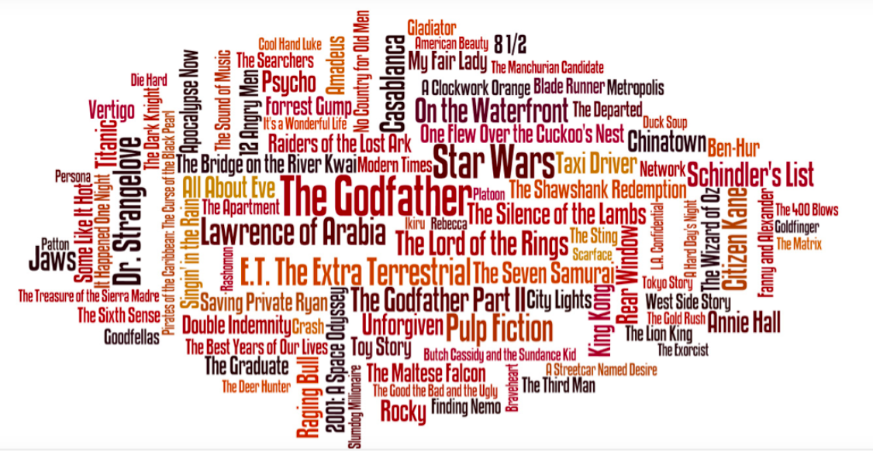
Thank you!

